Slide 1
Library Map Lightboxes at the
University of Birmingham
Edward Craft, IT Services
IGELU 2015, Budapest.

Slide 2

Library Map Lightboxes
University of Birmingham
Traditional UK ‘Redbrick’ university
Founded in 1900
29,000 FTE
ExLibris since…
  Metalib/SFX : 2005
  Primo/Verde : 2012
  Aleph : 2013

Slide 3
Library Map Lightboxes
The problem – “finding a book once you’ve found a book”
  23 Libraries, stores and sequences
  21 Zones just within the Main Library
  A printed hand-out = confused new students
The answer: use a computer!

Slide 4
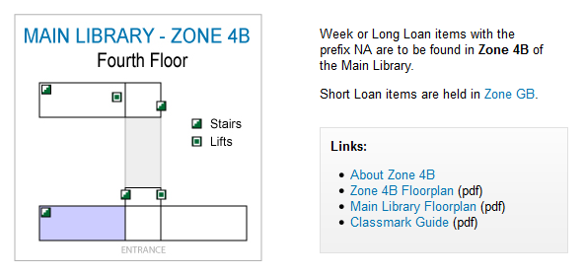
Library Map Lightboxes
http://libapps.bham.ac.uk/libmap/show.asp?s=Main%20Library
&l=&c=%28NA%20971.B5%20F%29

Slide 5
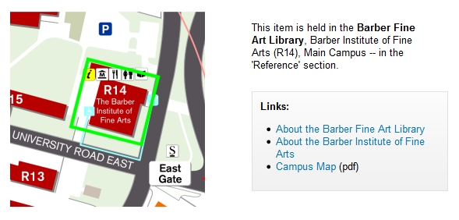
Library Map Lightboxes
http://libapps.bham.ac.uk/libmap/show.asp?s=Barber%20Fine%20Art%20Library&l=Reference&c=%28NA%20971.B5%20F%29

Slide 6
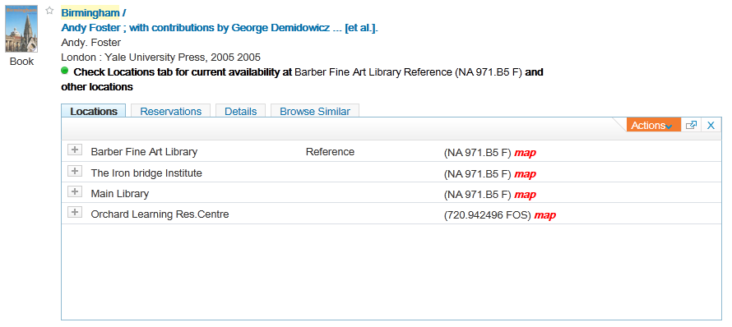
Library Map Lightboxes
Achieved by changing ExLibris’ code (NOTE: this was a Bad Idea!)

Slide 7
Library Map Lightboxes
The move to SaaS
  Pros: Scalability, Reliability
  Cons: SP scheduling, CL access!!!!
Using Static HTML and jQuery
Add jQuery in footer to add an onclick event to all Locations tabs, delay while the tab opens and then inject the link into each location line taking parameters from the existing values just populated…
  … check ExLibris’ Developer Network!

Slide 8
Library Map Lightboxes
“Can it ‘pop up’ instead of open in a tab?”
What is a Lightbox?
  Based on ExLibris own functionality
    Refine Further / Find Databases
  White box on a grey-washed screen.
  Very simple CSS/HTML
    … check ExLibris’ Developer Network! (again)

Slide 9
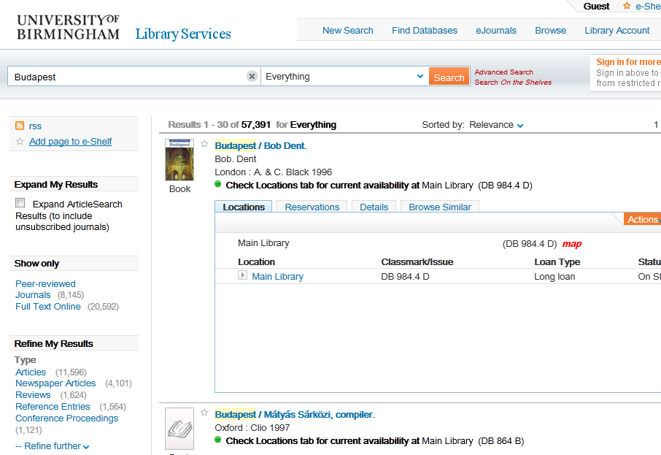
Library Map Lightboxes

Slide 10
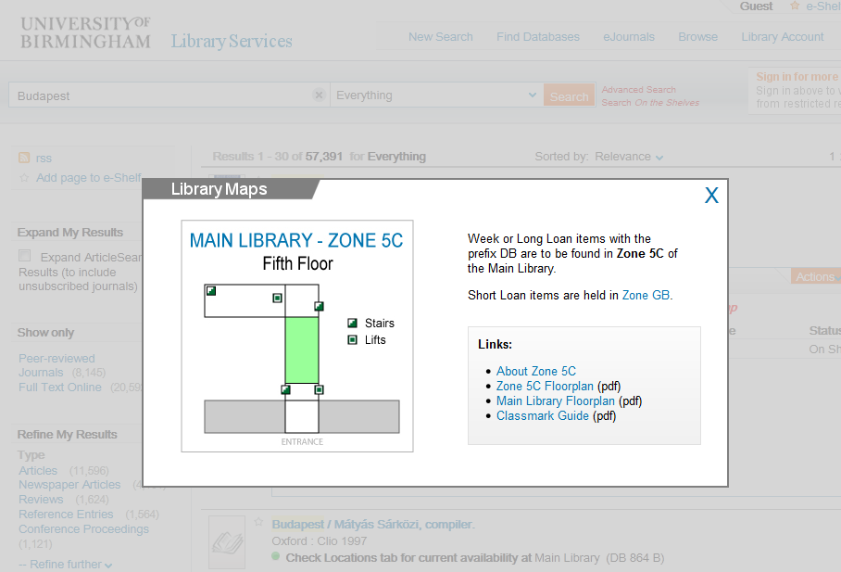
Library Map Lightboxes

Slide 11
Library Map Lightboxes

Slide 12
Library Map Lightboxes
“…all problems look like a nail”
What are Lightboxes good for?
  Things that you want one of
    SFX Menus X
  Things that have your attention
    Help / Ask a Librarian X
  Web ‘applets’ on any platform

Slide 13
Library Map Lightboxes
Examples
  Library Maps
    ASP (VBScript) on Windows 2013
  (Proprietary) Reading Lists Hierarchy
    Linux/Apache/MySQL/PHP
  SFX eJournals A-Z / HotArticles
    ExLibris - Unknown

Slide 14
Library Map Lightboxes
What next?
  New Library (Reclassification, stock moves, new building)
  Primo v5 – including its own library maps
  Additional functionality
    New Talis Aspire Reading Lists

Slide 15
Library Map Lightboxes
Thank You!
e.j.craft@bham.ac.uk
www.igelu.org

