Slide 1


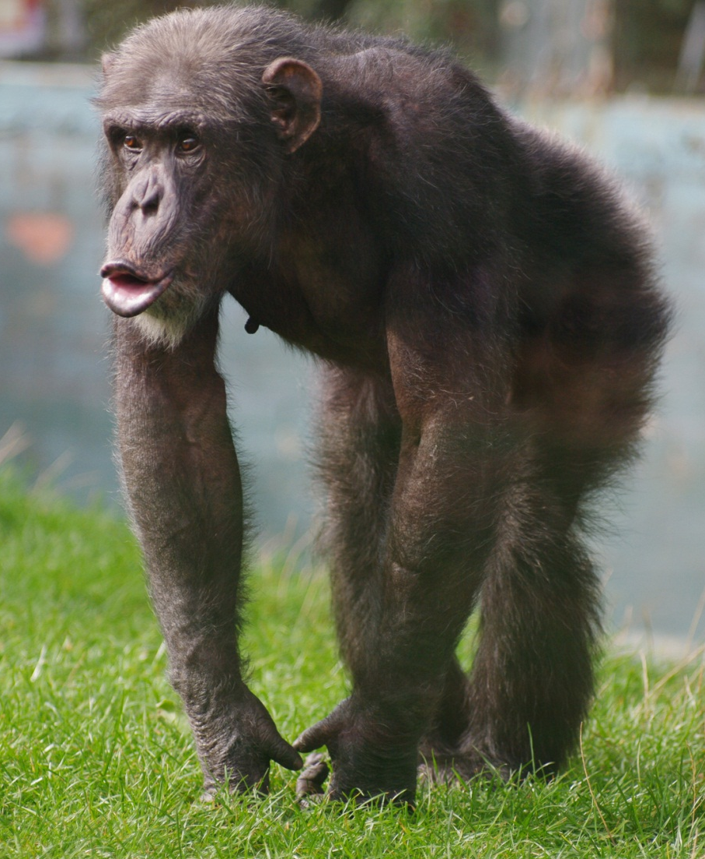
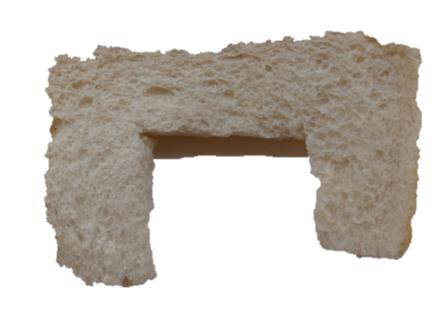
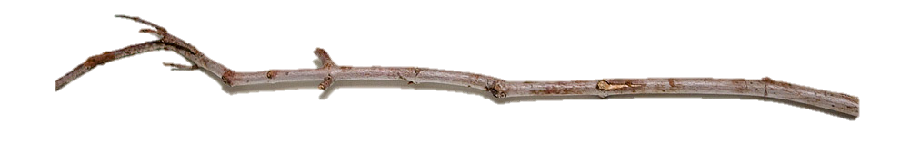

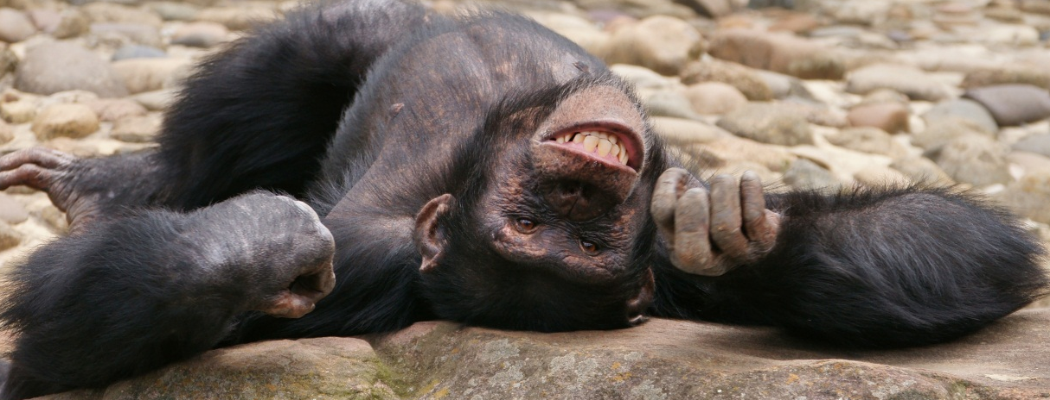

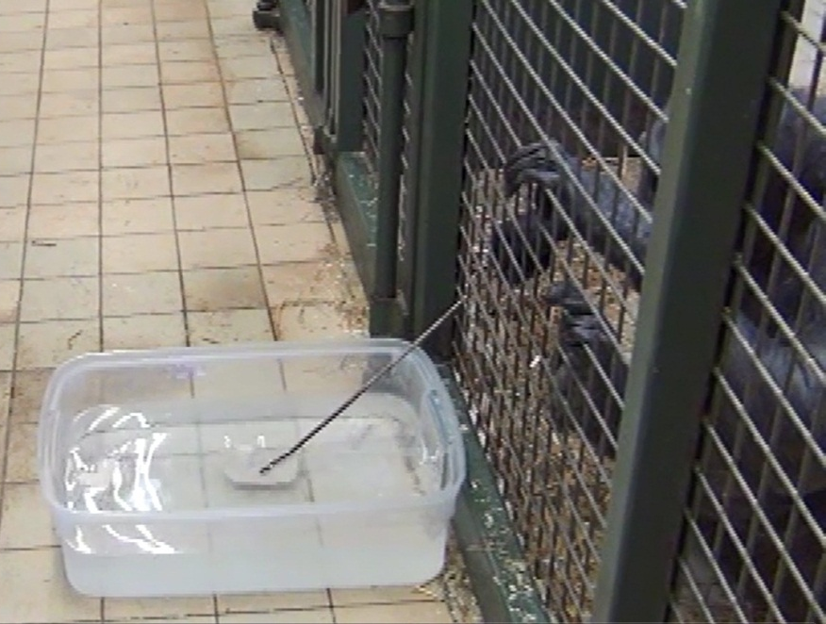
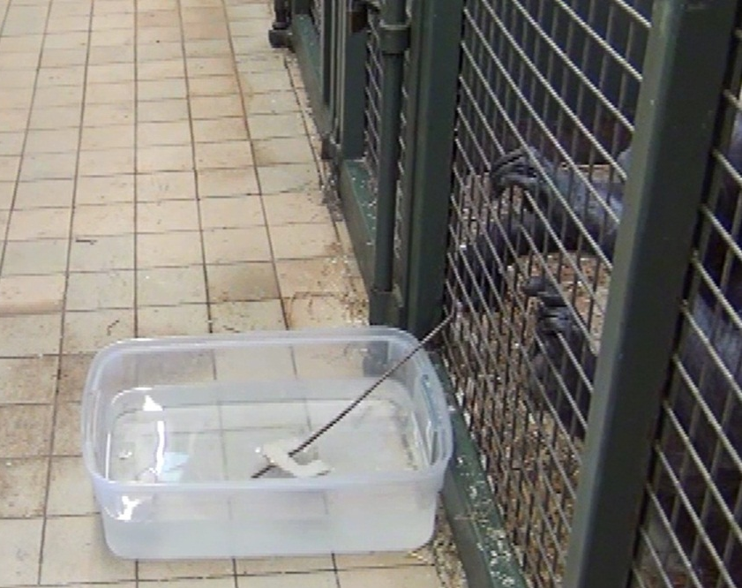
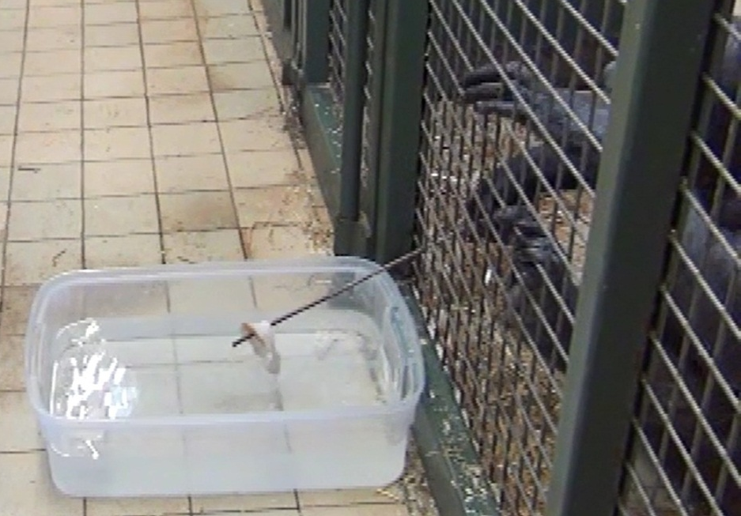
Can Naïve Chimpanzees Use Tools?
Elisa Bandini*, Sarah R. Beck and Claudio Tennie
School of Psychology, University of Birmingham *contact: exb402@bham.ac.uk
Introduction
Algae scooping is a behaviour in which wild chimpanzees in Bossou (Guinea) use tools to feed on aquatic algae by scooping and wrapping algae round the stick^{1.} Algae scooping has been suggested to require social learning to develop due to its rarity across other chimpanzee sites in Africa and differences in techniques within the community of Bossou². Here we argue that algae scooping does not necessarily require social transmission to develop but instead is within the chimpanzee’s ‘Zone of Latent Solutions’: their cognitive repertoire³.
Image courtesy of Twycross Zoo
Materials and Methods
We created a task that mimicked algae scooping with 14 naive captive chimpanzees (Group 1: 2 males and 3 females, mean age: 30.8 years, Group 2: 3 males and 6 females, mean age: 27.7 years) in order to see whether the behaviour emerged spontaneously or if it required some form of social learning to develop.
A plastic container (160mm x 662mm) was placed outside the enclosure’s mesh and filled with water and three crusts of hardened bread (cut into a half moon shapes). Bamboo sticks (length between 70cm and 100cm, diameter between 7cm and 9cm) were inserted inside the enclosure prior to the chimpanzees being allowed into the management area. All the chimpanzees within the group had access to the container and the bread for a testing period of 10 minutes.
farm9.staticflickr.com
Results
Within the first couple of minutes of testing one chimpanzee in each group used the sticks placed in the enclosure to reach for the bread. The majority of attempts to retrieve the bread were carried out using the same ‘scooping’ method seen by wild Bossou chimpanzees. Both chimpanzees who successfully carried out bread scooping were born and raised in captivity and had never been exposed to similar tasks (and thus were completely naïve to the technique).
Photos by EB showing the process of algae scooping by captive chimpanzees.
Conclusions
This study suggests that algae scooping is within chimpanzee’s cognitive repertoire as the behaviour occurred spontaneously in two separate groups of naïve chimpanzees. Social transmission may play a role in the spread of the behaviour, but it is not essential for algae scooping to appear. This holds important implications for many other chimpanzee behaviours that have been said to require social learning as they may actually be part of the specie’s Zone of Latent Solutions. Future studies into chimpanzee cognition may also aid in understanding the evolution of human tool use.
References
¹Matsuzawa, T.,Humle, T.,Sugiyama, Y. (2011) The Chimpanzees of Bossou and Nimba. Tokyo: Springer Science, Business and Media.
³ Matsuzawa, T., Yamakoshi G., Humle, T. (1996) A Newly Found Tool Use by Wild Chimpanzees. Algae Scooping. Primate Res 12: 283.
⁴ Tennie, C.,Call, J.,Tomasello, M. (2009) Ratcheting up the Ratchet: On the Evolution of Cumulative Culture. Phil.Trans.R.Soc 364: 2405-2415.
Acknowledgments
This research was made possible through funding from the Economic and Social Research Council and much appreciated collaboration from Twycross Zoo.

