Slide 1
Text & Data Mining, & Copyright
Alex Fenlon, Head of Copyright & Licensing,
Libraries & Learning Resources,
University of Birmingham.

Slide 2

Outline of the session
What is TDM?
Legal Issues
E-resource terms and conditions
The TDM Project
AI & TDM

Slide 3
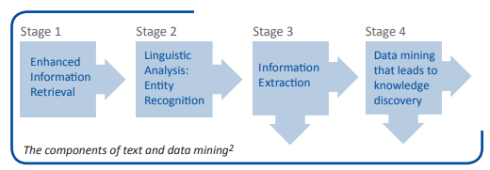
What is TDM?
“Text and data mining (TDM) is the process of deriving information from machine-read material. It works by copying large quantities of material, extracting the data, and recombining it to identify patterns.”
“The bottom line is that text and data mining is concerned with the extraction of facts and data from vast quantities of material for research purposes, and not with substituting the original material.”
LIBER Europe Fact Sheet “Text and Data Mining”

Slide 4
What is TDM? (2)
“Text and data mining (TDM) is the process of deriving information from machine-read material. It works by copying large quantities of material, extracting the data, and recombining it to identify patterns.” Supporting Document T
Text Mining and Data Analytics in Call for Evidence Responses, UK Government (~2011-14?)
‘text and data mining’ means any automated analytical technique aimed at analysing text and data in digital form in order to generate information which includes but is not limited to patterns, trends and correlations” Article 2 (2), Definitions CDSMD 2019

Slide 5
What is TDM? (3)
“New technologies enable the automated computational analysis of information in digital form, such as text, sounds, images or data, generally known as text and data mining. Text and data mining makes the processing of large amounts of information with a view to gaining new knowledge and discovering new trends possible..” Recital 8, CDSMD, 2019
“Union law provides for certain exceptions and limitations covering uses for scientific research purposes which may apply to acts of text and data mining. However, those exceptions and limitations are optional and not fully adapted to the use of technologies in scientific research. Moreover, where researchers have lawful access to content, for example through subscriptions to publications or open access licences, the terms of the licences could exclude text and data mining. As research is increasingly carried out with the assistance of digital technology, there is a risk that the Union's competitive position as a research area will suffer, unless steps are taken to address the legal uncertainty concerning text and data mining.” Recital 9, CDSMD, 2019

Slide 6
Prof Hargreaves’ Crystal Ball?
“Digital Opportunity A Review of Intellectual Property and Growth”, Hargreaves , 2011.
5.22 “the question is how to build in sufficient flexibility to realise the benefits of new technologies, without losing the core benefits to creators and to the economy that copyright provides.”
5.24 “In data mining or search engine indexing, copies need to be created for the computer to be able to analyse; the technology provides a substitute for someone reading all the documents. This is not about overriding the aim of copyright – these uses do not compete with the normal exploitation of the work itself – indeed, they may facilitate it. Nor is copyright intended to restrict use of facts. That these new uses happen to fall within the scope of copyright regulation is essentially a side effect of how copyright has been defined, rather than being directly relevant to what copyright is supposed to protect.”

Slide 7
So… What is TDM?
Computational analysis”
NLP/
Sentiment analysis/ Linguistical analysis
Machine learning
“Big data”
Training AI?

Slide 8
UK Law
UK Copyright Designs and Patents Act 1988 –
Section 29A Copies for text and data analysis for non-commercial research
Copying for is not copyright infringement if:
You have lawful access to the content/ data/ copyright works.
It's for “computational analysis”.
It's solely for non commercial research.
Includes sufficient acknowledgement (unless impractical).
Infringement occurs if:
The copy is transferred or used for other purposes without permission.
The copy is sold, hired, or offered commercially.
Contract terms restricting lawful TDM copying are unenforceable.

Slide 9
EU Law- Art 3
EU Copyright in the Digital Single market Directive (CDSMD) 2019
Article 3 – “Text and data mining for the purposes of scientific research”
Applies to “research organisations” & “cultural heritage institutions”
Allows copying & mining of works with lawful access
Must be for scientific research only
Copies may be retained securely for verification
Rights holders are allowed to protect the integrity and security of their hosting platforms.
Contract terms restricting lawful TDM copying are unenforceable (Art 7.1 CDSMD)

Slide 10
EU Law- Art 4
EU Copyright in the Digital Single market Directive (CDSMD) 2019
Article 4- “Exception or limitation for text and data mining”
Applies to anyone
Allows copying & mining of works with lawful access
For any purpose
Copies may be retained securely for verification
Rights holders can opt out in an appropriate manner, such as machine-readable techniques
[PS- Both Arts 3 & 4 are still subject to intense debate and criticism especially re AI training]
[PPS- AI Act confirms the valid application of TDM exceptions to AI, see recitals and Art 53(1)(C)]

Slide 11
Comparison of UK vs EU law
 | UK Law CDPA Section 29A | EU Law CDSMD Art 3 | CDSMD Art 4
Effective From | 01/06/2014 | 06/06/2019 Transposition deadline 07/06/2021 | 06/06/2019 Transposition deadline 07/06/2021
Purpose | Non-commercial research | Scientific research by research organisations and cultural heritage institutions | Any purpose by anyone
Beneficiaries | Researchers with lawful access | Non-profit research organisations and cultural heritage institutions | Any individual or organisation with lawful access
Lawful Access Required | Yes | Yes | Yes
Retention of Copies | Allowed for verification | Allowed for verification | Allowed as long as necessary
Contract Override Protection | Yes | Yes | No
Commercial Use | Not permitted | Not permitted | Permitted unless rights are reserved
Mandatory for Member States | UK-specific; not harmonised | Yes * | Yes *
Opt-Out by Rights Holders | Not applicable | Not allowed | Must be explicitly reserved
* This is a Directive meaning Member states can implement how they see fit, i.e. they can choose the precise form and wording on their national exception within the framework of the CDSMD

Slide 12
Issues with UK Law
UK Copyright Designs and Patents Act 1988 –
Section 29A Copies for text and data analysis for non-commercial research
Copying for is not copyright infringement if:
You have lawful access to the content/ data/ copyright works.
It's for computational analysis.
It's solely for non commercial research.
Includes sufficient acknowledgement (unless impractical).
Infringement occurs if:
The copy is transferred or used for other purposes without permission.
The copy is sold, hired, or offered commercially.
Contract terms restricting lawful TDM copying are unenforceable.

Slide 13
Issues (2)
Lawful access
Openly visible online?
Subscriptions or printed copies held in libraries?
Contracts that expressly state no TDM or law is not UK/ EU or US?
Computational analysis
Web scraping/ harvesting/ spiders/ crawlers? NLP? Semantic analysis?
AI training?
Non Commercial research
Public private partnerships/ Knowledge exchange/
Valorisation/ Translational research
Impact?

Slide 14

Issues (3)
Sufficient acknowledgement
Title, author, date, publisher, owner. source?
1,000,000+ sources/ rows?
Impossible vs impractical
Data sharing
Collaborative research
Internal/ external, International
Public Private partnerships
Reproducibility/ Validity requirement
Open Science obligations
Many of these criticisms can be directed at the CDSMD too.

Slide 15
Issues (4)
Still untested in UK courts.
Getty Images Vs Stability AI (November 2025) came close but the question of model training was abandoned because it was “accepted that the training and development of the Model did not take place in the United Kingdom”.
Although Getty’s images were used in training, the AI model does not store or reproduce those images directly.
Decision- No copyright infringement found.

Slide 16
UK Govt AI/ TDM Consultation
Gov proposed a new wide UK TDM exception like Art 4 in 2022.
Any purpose
Lawful access
No opt out
Creative sector objected hugely, Govt finally abandoned in February 2023.
New consultation closed in Jan 2025
11,000+ submissions
still waiting outcome
Round tables/ expert meetings taking place

Slide 17

(pause)
Notes:
AF

Slide 18
Data mining content
Legal access to content
On line access, open or subscription
Collections - print and digital
Digitised content can be included
UK TDM exception since 2014 & EU CDSMD since 2019
Still see licences actively preventing TDM or the use of web harvesting technologies

Slide 19
E-resource Licences- example 1
Licensee and its Named Users shall not:
Create or compile, directly or indirectly, manually, via automated programing, or otherwise (e.g., a script written to extract and download any data within the Product in batches), a collection, compilation, database or directory from the Product;
Use any script/macro to automate an otherwise manual process, including but not limited to, an attempt to login to the Product utilizing an automated process;
Use the Product for the purposes of machine learning, algorithmic development, testing or enhancing, or any other artificial intelligence purposes;

Slide 20
E-resource Licences- example 2
Neither Licensee nor Authorized Users shall:
...
systematically download any Content to its own or any third-party server, use routines designed to continuously and automatically search and index the Content (full text and metadata), such as web-crawling or spider programs or engage in any activity likely to burden the Platforms, except as expressly allowed in the License Agreement,
…
use any part of the Content (including without limitation any data derived from the Content) to develop, train, program, improve, and/or enrich, directly or indirectly, any AI model or system which is or may be accessible by a third party (other than Licensee and Authorized Users), or permit third parties to do so. Notwithstanding the foregoing, Licensee and Authorized Users are not prohibited to use limited portions of the Content in prompts and queries in an AI system.

Slide 21
E-resource Licences- example 2 goes on…
For clarity, any use of Content by Licensee or Authorized Users in connection with
a) an AI model or system only accessible to Licensee and Authorized Users, or
b) using portions of the Content in prompts or queries with a third party AI model or system
are not subject to the rights granted in this License Agreement and are Licensee’s or Authorized Users sole responsibility. Licensee acknowledges and accepts that Licensor extends no representations or warranties, whether express or implied, as to the legality or non-infringement of such activities as described in this section.

Slide 22
E-resource Licences- example 3
Restricted Use. Unless the express prior written consent of XXXX is obtained, Licensee shall not, and shall cause its employees, agents, and any third party acting on Licensee’s behalf not to use any XXXX Content for the purpose of creating, training, enhancing, developing, maintaining, or contributing to any AI, Machine Learning System, or Large Language Model, whether owned by Licensee or any third party. Without limiting the generality of the foregoing, this prohibition includes, but is not limited to, the following actions:
(a) Uploading, transmitting, or otherwise providing XXXX Content to any AI, Machine Learning System, or Large Language Model for training or incorporation into their datasets;
(b) Using XXXX Content as a source, training set, or benchmark for any AI, Machine Learning System, or Large Language Model;
(c) Using XXXX Content to engage in any activity that may directly or indirectly result in the development, improvement, or expansion of an AI, Machine Learning System, or Large Language Model;
(d) Using services, software or any manual or automatic device, tool, or process designed to circumvent any restriction, condition, or technological measure that controls access to the XXXX Content in any way, including overriding any security feature or bypassing or circumventing any access controls or use limits of the XXXX Content;

Slide 23
E-resource Licences- example 3 cont.
For the avoidance of doubt, the Licensee further agrees not to engage in any of the following activities:
…
(i) Data Mining: Licensee shall not engage in data mining, scraping, or any similar activities to extract or collect data from the XXXX Content for use in an AI, Machine Learning System, or Large Language Model.

Slide 24
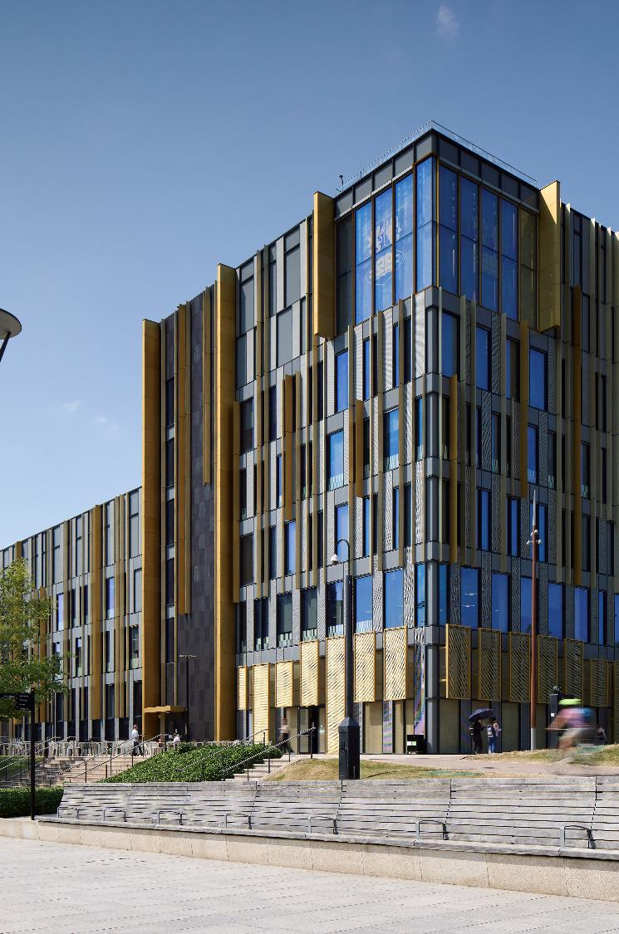
(Pause)

Slide 25
TDM Project
2022 Library sent TDM survey to academic staff & PGRs:
Had a 15% response rate with responses from all five Colleges (~40- 50 separate responses)
78% of respondents were already involved in TDM projects or were not involved but wanted to be.
17% reported issues with skills
17% reported issues with data availability

Slide 26
Addressing the TDM Skills Gap
Who supports skills development?
Copyright & Licensing Team
Research Skills Team
Academic Skills Centre
BEAR (IT Services)
Colleges/ disciplines?
How do we upskill Library staff?
LinkedIn Learning, BEAR Coding Basic Course, Code First Girls,
RLUK DSN, CILIP UKeiG, mailing lists, UKSG,
Gale Digital Scholar Lab etc.

Slide 27
AI in 2023
In 2023, we posed several questions
How will generative AI tools impact TDM activity?
Are there trust/ integrity issues?
Can researchers see ‘under the bonnet’ of AI tools enough for large-scale TDM projects?
What are the copyright & licensing implications of using and contributing to such tools?
Are there reproducibility concerns?
How are ethical concerns addressed??
Notes:
Can you upload 3rd party data to AI tools? What licences to you grant them in doing so? What permissions do you need to use the tools? Are they as Open as they say? What’s the trade off?

Slide 28
TDM & AI
AI tools are helping to democratise TDM activities
Reducing the technical skills requirements to develop and deploy computational methods
Opening up scope, scale and speed of projects
Easier for more people to engage
More TDM tools available
More AI enable tools available
AI LLM tools have excellent capabilities to enable analysis

Slide 29
TDM & AI – Licence clauses
More tools have licence clauses that require licences to uploaded/ input content/ data
Transkribus:
We need your permission to use your User Content, ….. Therefore, you grant READ-COOP the worldwide, royalty-free, transferable, sublicensable and non-exclusive licence to use the User Content exclusively for the purpose of providing and improving our Products and Services….
In particular, you grant READ-COOP
a. The right to store, modify, and process the User Content, and
b. The right to communicate, publicly perform or display, and transmit the User Content, exclusively if You have made it publicly accessible through a service provided by READ-COOP

Slide 30
TDM & AI – Licence Clause (2)
Elicit
By using the Service or establishing an Account and registering as a Member, you:
expressly grant us a limited, non-exclusive, worldwide, fully paid, perpetual, irrevocable, transferable right and license to use, display, perform, copy, modify, create derivative works, and distribute Your Content (including any derivative works) for the purposes of: (i) providing the Service to you; and (ii) to the extent you indicate that Your Content may be shared with other users of the Service, to provide other users of the Service with access to and use of the shared portion of Your Content;
represent and warrant that you have all necessary rights, licenses, and authority to provide us with the licenses and permissions granted to Your Content; and
represent and warrant that you will comply at all times with applicable laws and with any terms, conditions, and policies imposed by any Third-Party Services (defined below) with which you choose to use the Service.

Slide 31
TDM & AI (2)
More tools place liability burdens on users and institutions for the tool’s use of that data
Perplexity
“By entering into these Terms and accessing or using the Services, you agree that you shall defend, indemnify and hold the Company Entities harmless from and against any and all claims, costs, damages, losses, liabilities and expenses (including attorneys’ fees and costs) incurred by the Company Entities arising out of or in connection with: (a) your violation or breach of any term of these Terms or any applicable law or regulation; (b) your violation of any rights of any third party; (c) your misuse of the Services; (d) Your Content; or (e) your negligence or wilful misconduct.
If you are obligated to indemnify any Company Entity hereunder, then you agree that Company (or, at its discretion, the applicable Company Entity) will have the right, in its sole discretion, to control any action or proceeding and to determine whether Company wishes to settle, and if so, on what terms, and you agree to fully cooperate with Company in the defense or settlement of such claim.”

Slide 32
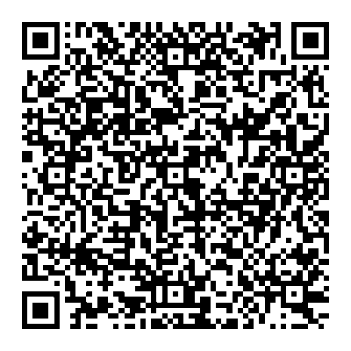
Researcher Led project 2024/25
Funded research looking at how AI could be used for rapid reviews.​
Aware of our work from a LLR work.
Asked to review licences for 8 products.​
Created AI tools licensing review tool- 42 fields. ​
Allows easy comparison of AI tools.​
Saves time – no need to read the same licence more than once.​
Communicates and highlights differences in licence terms.
(And a quick one with 10 fields!)

Slide 33
AI in 2025
In 2025, we’d pose several questions
How will generative AI tools impact TDM activity?
Are there trust/ integrity issues?
Can researchers see ‘under the bonnet’ of AI tools enough for large-scale TDM projects?
What are the copyright & licensing implications of using and contributing to such tools?
Are there reproducibility concerns?

Slide 34
2025 & Beyond:
Skills/ expertise development & Knowledge sharing
What is TDM/ AI
How is it used
What can it do
Licence reviews & engagement with content suppliers to use exceptions
Supporting researchers
National and international collaboration
Lobbying for consistent and coherent law
Notes:
AF

Slide 35


Thanks!
Thanks
© Alex Fenlon, Libraries and Learning Resources, The University of Birmingham, 2025, licensed under CC BY 4.0 licence
Notes:
AF

